Slide 1
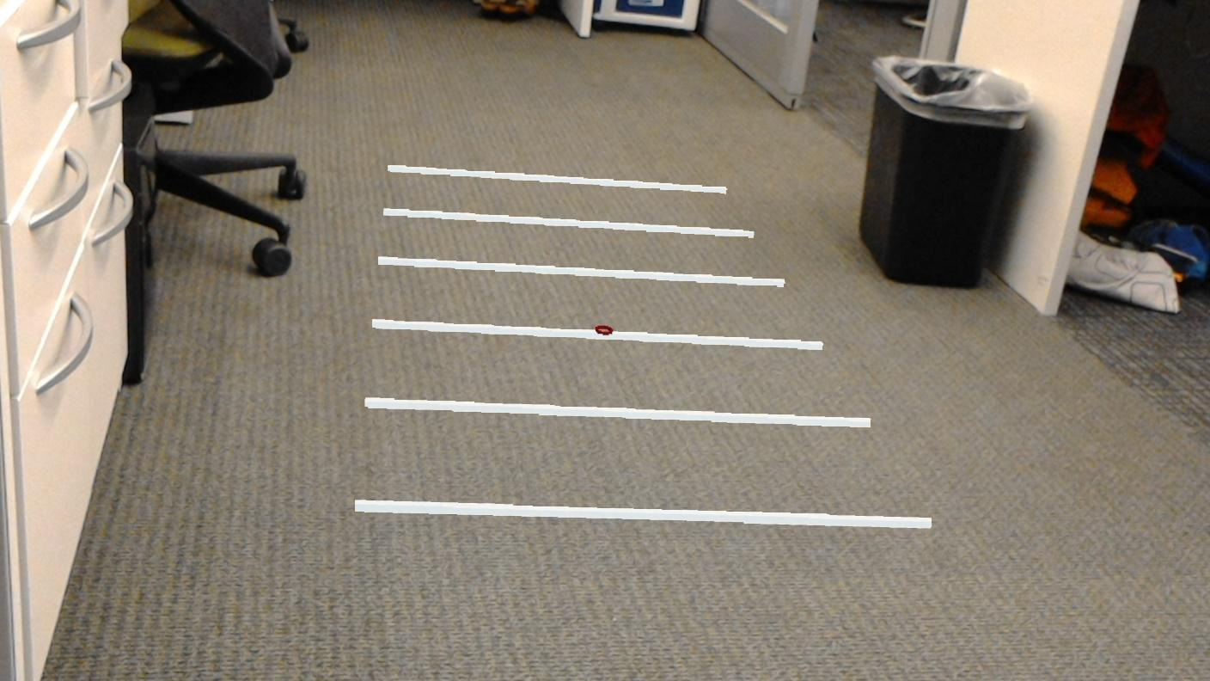
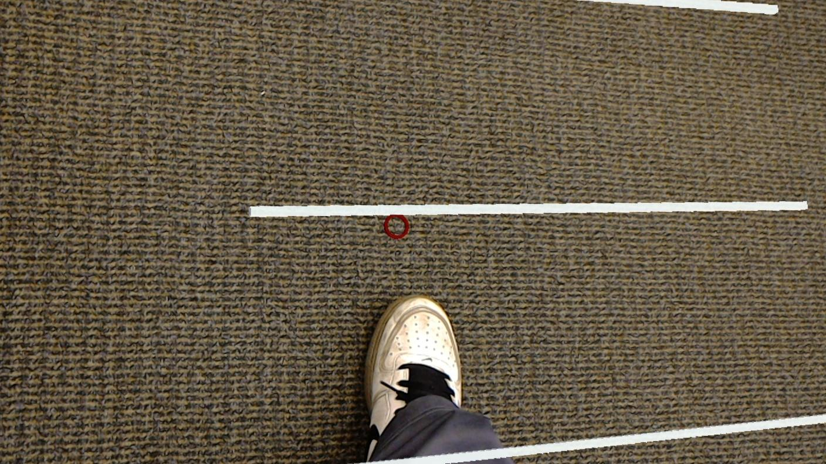
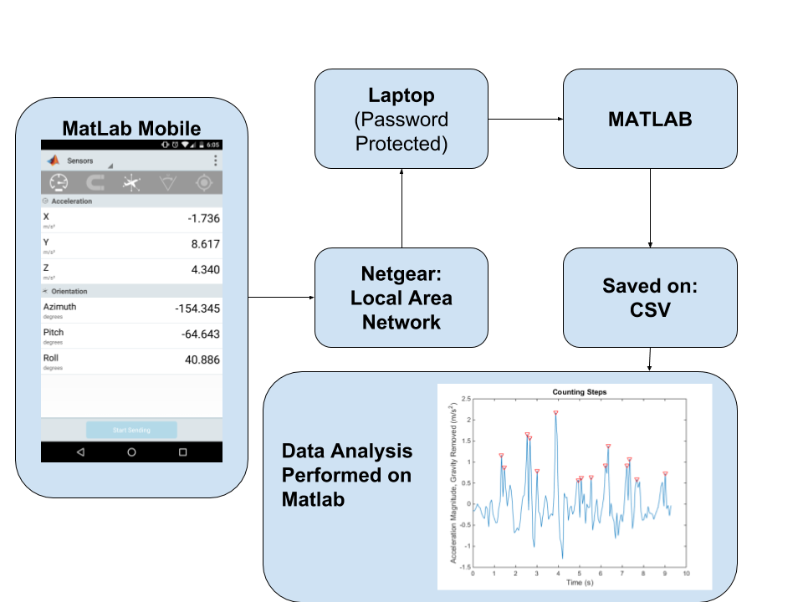
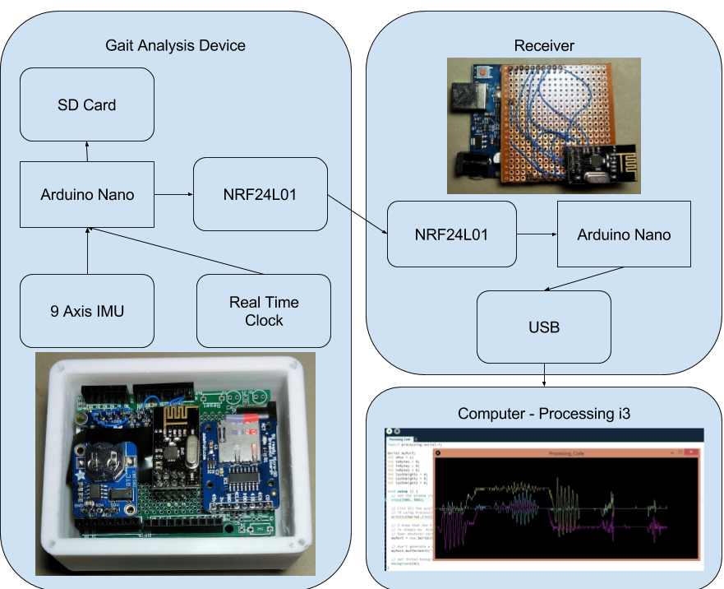
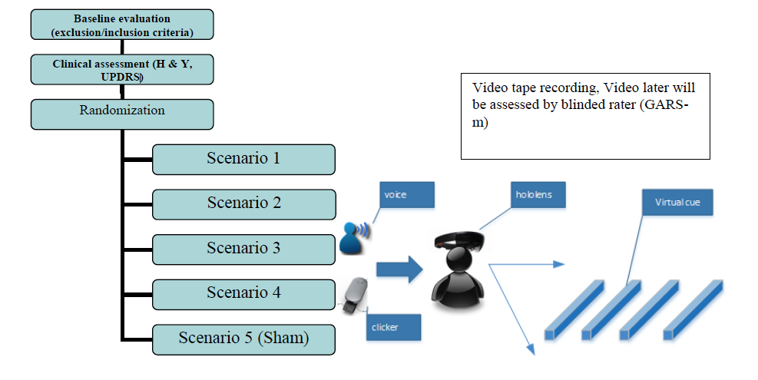
Undergraduate
Category: Engineering and Technology
Degree Seeking: Computer Engineering
Abstract ID: 1589
Augmented Reality for Parkinson’s: An Assistive Tool Based on Visual Cues
Justin Hynes-Bruell, Shuangjun Liu Advisor: Sarah Ostadabbas
Opportunity
Abstract: Parkinson’s disease (PD), with a prevalence of about 1% in people over the age of 60, usually presents itself with slowing of movement and tremors. PD is also strongly associated with problems of gait which predispose to falls and freezing of gait (FOG). It has been shown that one reason for FOG is difficulty with perceiving surroundings and misinterpreting cues received from the environment. One way to overcome this problem is to augment the cues that a patient with PD receives from her surroundings. Rather than providing physical cues which are also visible by others and usually broadcast disabilities, this research proposes to provide virtual cues to the patient in realtime, generated in a wearable Augmented Reality (AR) environment. To investigate the effectiveness of the AR cues generated using Microsoft Hololens AR glasses, we will compare gait variables and functional mobility of PD patients with FOG during walking with and without receiving our AR visual cues. As a proof of concept study, 15 PD patients who meet our inclusion and exclusion criteria will be recruited at Tufts Medical Center to achieve the following specific aims: (1) develop apps of multiple visual spatial cues in Microsoft Hololens AR glass environment, and (2) conduct a multi-scenario experimental study to verify the effectiveness of AR visual spatial cues in FOG symptoms improvement.
Goal or Aim: We anticipate that the proposed assistive tool will enhance the quality of life of patients with PD by helping them to overcome FOG, which otherwise could hinder their everyday physical activities.
Results and Data
Three platforms have been completely developed. We are now waiting to collect experiential data with Parkinson's Disease patients according to our IRB with Tufts University.
Figure 2: First person perspective of Hololens
Figure 3: Data Collection Platform using Phone
Figure 4: Data Collection Platform using Arduino
Approach
We are considering different AR scenarios as visual cues during a 50m walk experiment:
30cm apart white lines in front of the user to up to 3m
30cm apart white lines with height to mimic the sense of obstacle crossing
30cm apart changing color lines based on the distant from the user
moving lines which can be adjusted based on the user walking speed
During each of these scenarios, after adding two data collection platforms to the user, while walking, we compare the efficacy of our intervention based on the speed of the walk, number of gait freeze, etc. Following is experiment record of our initial demo to test the system effectiveness. Figure 2 Real-time snapshot of the AR visual cues from scenario (1) of our experiment In this initial demo, the 6 white lines are visual cues generated on Hololens. They will attach to the ground in subject’s heading direction whenever needed. The red circle indicate the current gazing direction of the user. From the real-time snapshot, we can see our app successfully embedded the visual cues to the real environment on the ground which can act as reference for PD patient with freezing gait.
Impact
The unique feature about my innovation/research is: It’s use of augmented reality technology to discretely and effectively improve the mobility of Parkinson's Disease patients suffering for Freezing of Gait.
This addresses the problem of: “Freezing of Gait” with Parkinson's Disease patients.
Initial phase of this study includes 15 patients as proof of concept experiment. After this initial phase, intellectual property claim will be filed for a tentative patent on AR4PD. In second phase of the study more patients will be recruited and study results will be published in related peer–reviewed medical journals.
Figure 1: Approach for testing

